Slide 2
TERRITORY
OF THE REPUBLIC OF TATARSTAN

Slide 4
STRATEGY 2030
A man is a highest value
TATARSTAN
2030
Human comfort (ecology, education)
Demography, medicine
New economy

Slide 5
The Main Aim of the Strategy:
Creation of favorable environment for the development of people
A man is the basis of new economy, the heart of the success in global competitiveness

Slide 7
TATARSTAN ECONOMICS
bln RUB

Slide 12
TERRITORY OF ADVANCED SOCIAL-ECONOMIC DEVELOPMENT
 | Standard rate | Chelny city
Income tax | 20% | 0-5%
Land tax | 1,5% | 0%
Corporate property tax | 2,2% | 0%
Insurance contributions | 30% | 7,6%

Slide 13
Education and Science
Academy of Sciences of Republic of Tatarstan
Kazan Federal University
Over 70 universities
HR centers for investors
Lifelong training for government & buisiness

Slide 14
World Skills International
Development of professional education
Professional skills competition
Currently the WS organization includes 71 territories
50 competencies

Slide 15
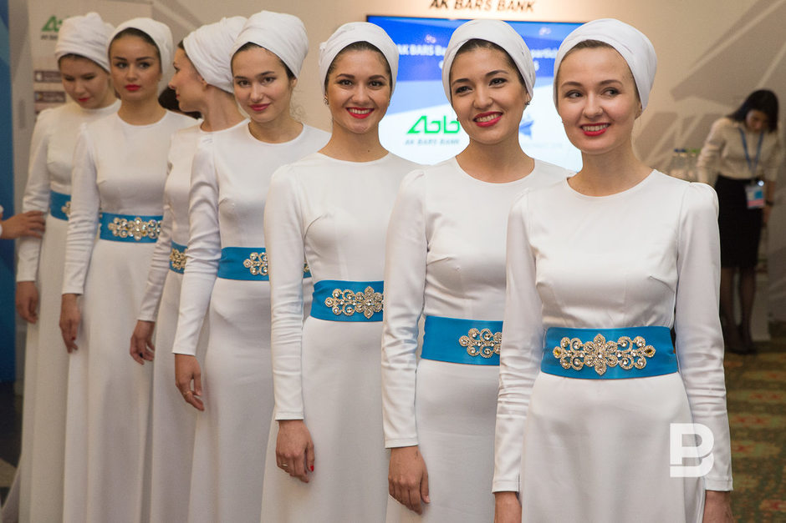
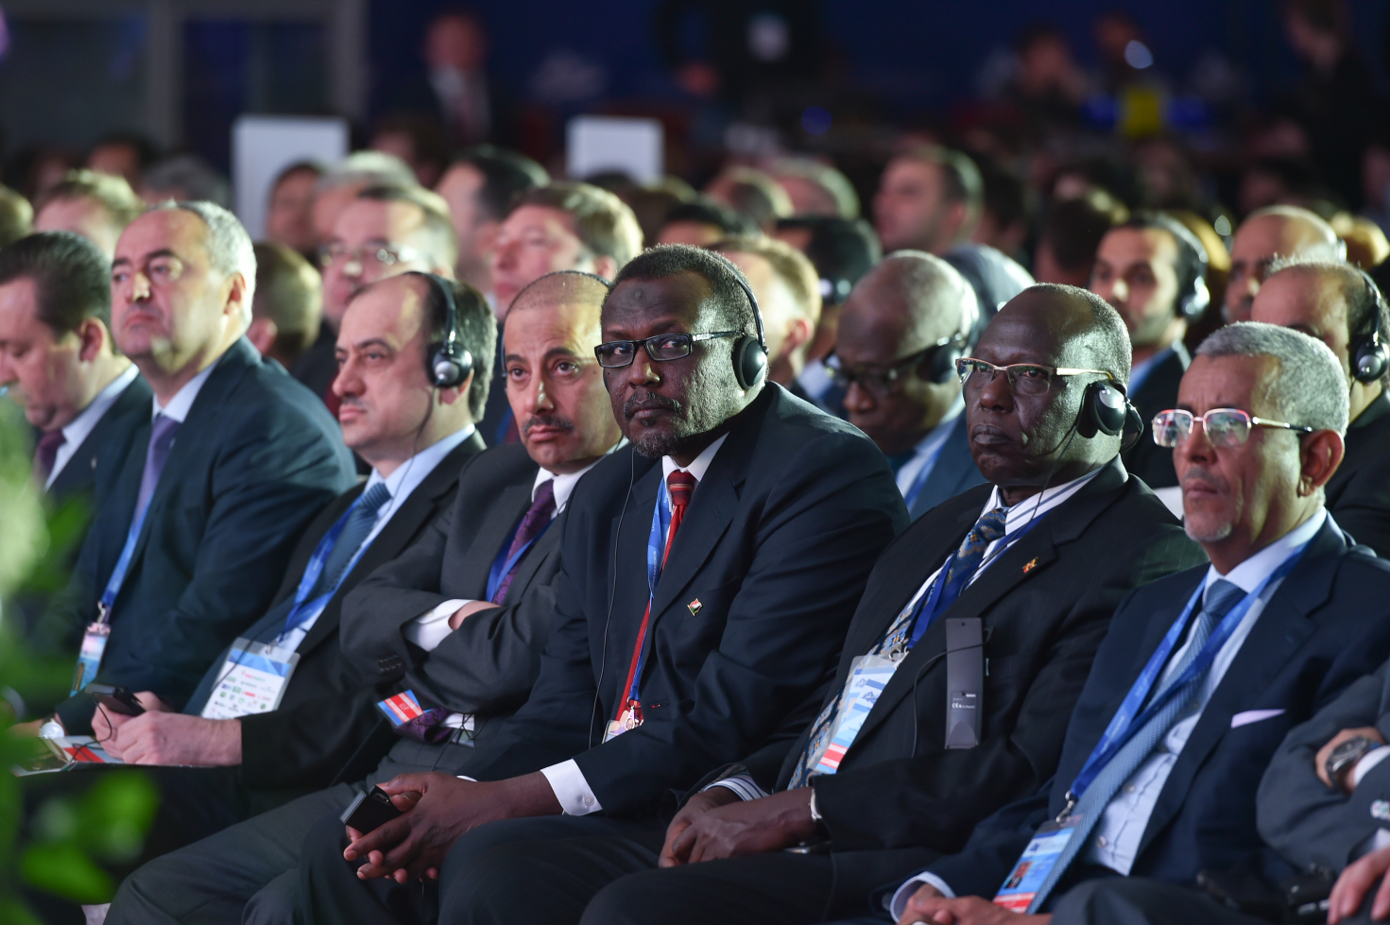
The International Economic event «Russia and Islamic World: KazanSummit»

Slide 16
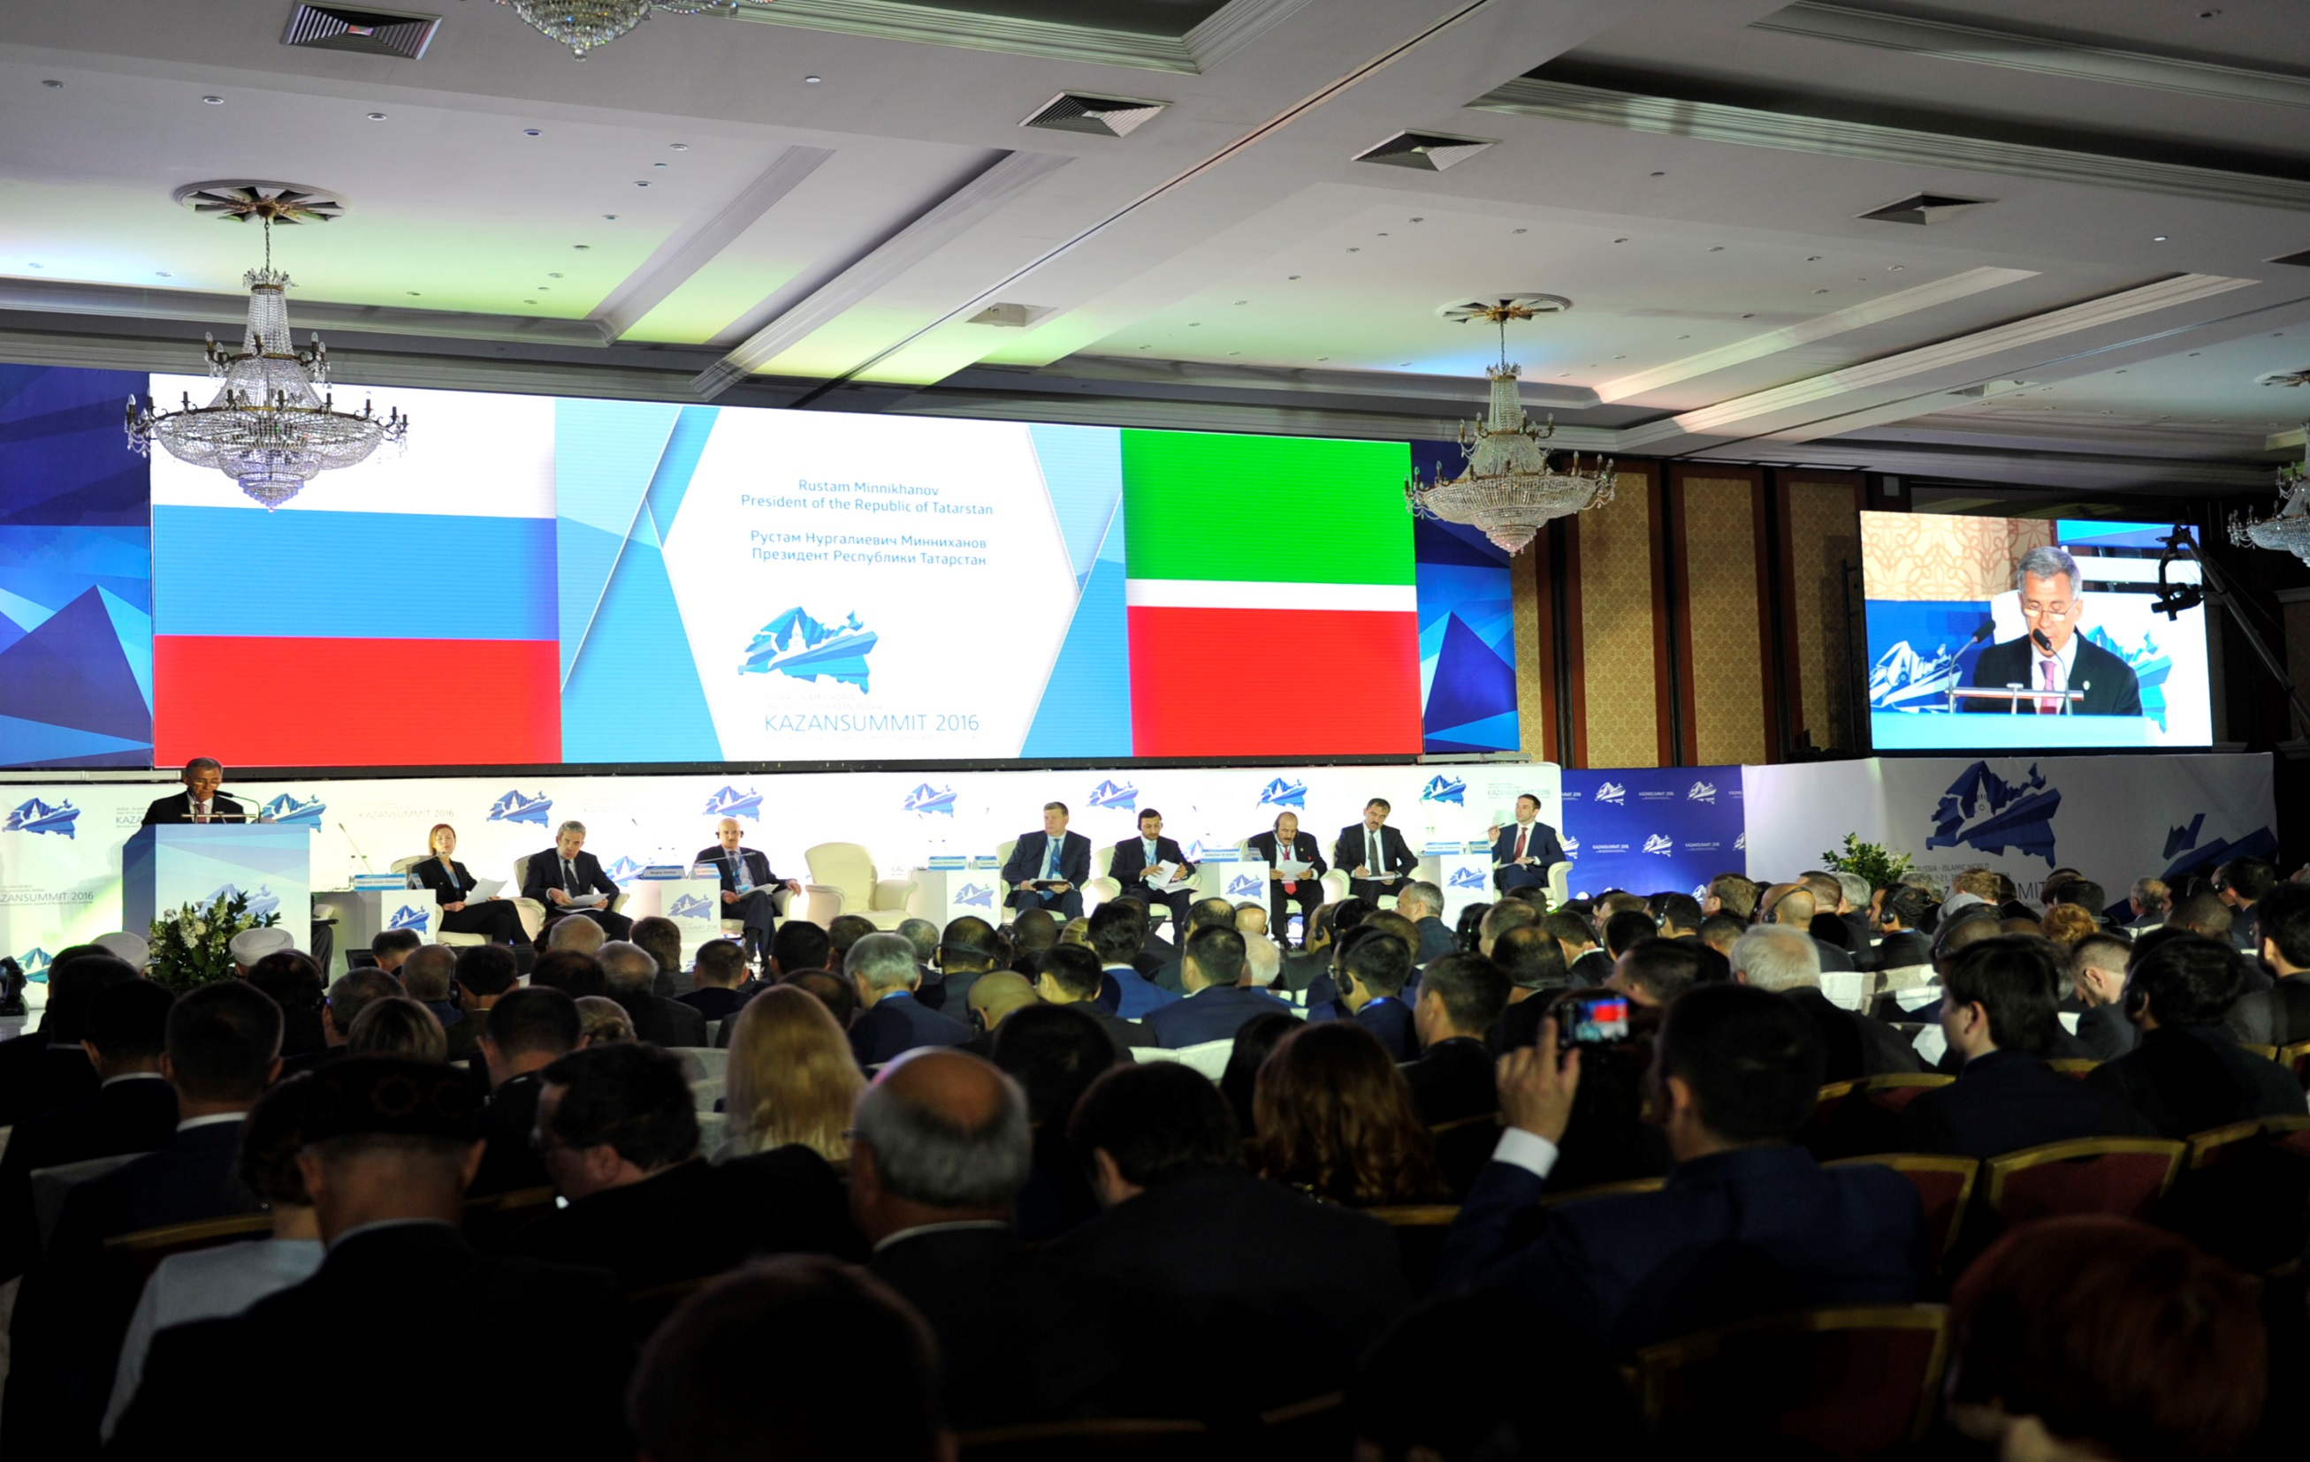
kazansummit.ru
kazansummit.ru

Slide 17
INVEST.TATARSTAN.RU

Slide 18
WELCOME TO TATARSTAN!

